Slide 1
Cloud Computing acronyms and concepts
Mamata Geloth

Slide 2
Cloud Computing acronyms
Private Cloud
A combination of IT Infrastructure (servers, storage, networking, virtualizaiton, …..) which is running in a centralized datacentre, and consumed by the organization itself.
Public Cloud
A combination of IT Infrastructure (servers, storage, networking, virtualizaiton, …..) which is running in a centralized datacentre, and offered by a service provider, to be consumed by the many different organizations.
Hybrid Cloud
An organization uses a combination of a private cloud infrastructure and a public cloud infrastructure.

Slide 3
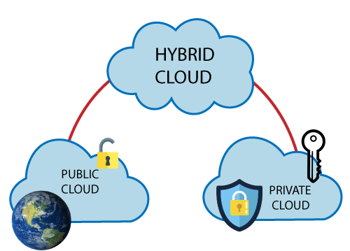
Cloud Computing acronyms

Slide 4
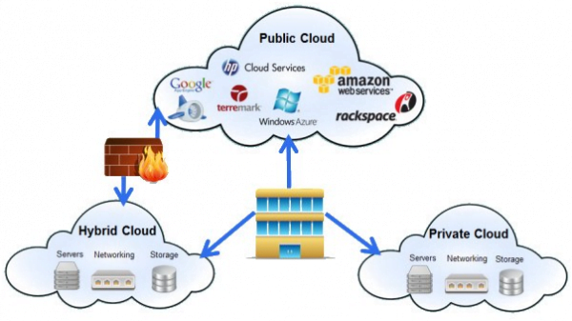
Cloud Computing acronyms

Slide 5
Cloud Computing acronyms
Public Cloud examples- AWS, GCP, Azure, IBM, Oracle
Private Cloud examples - VMware, HPE, Dell, Openstack
Hybrid Cloud - Rackspace, VMware, Cisco, IBM

Slide 6
Cloud Computing acronyms
IaaS - Infrastructure-as-a-Service
SaaS - Software-as-a-Service
PaaS - Platform-as-a Service
DaaS- Desktop-as-a-Service

Slide 7
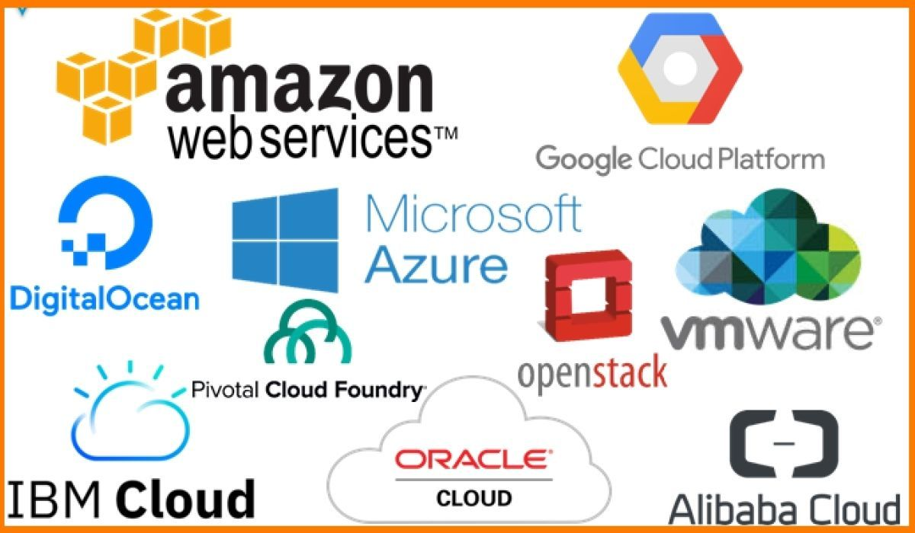
Some Public Cloud Computing Vendors

Slide 8
Frequently Asked Questions (FAQs)
What is the main difference between the public vs private cloud?
Is a private cloud better than a public cloud?
Are AWS and Google Cloud private or public?
What are examples of the hybrid cloud and public vs private clouds?

